Slide 1
Motivation
Personality Development
&
Time Management
:- Manoj Kumar
D.G.M. Brand, Dainik Jagran

Slide 2
Motivation
Motivation is the force that leads people to act to achieve their objectives. It is the activators of human behaviors to do something. People are willing to act bacause they are motivated toward their goals.
The driver of their actions may be money need, success need, position need, and their best potentiality.

Slide 3
Motivation
Motivation is the art of inspiring and encouraging subordinates or people to do work effectively so that both organizational and individual goals can be achieved.

Slide 4
The phrase motivation is derived from the word ‘motive’. As a noun motive means an objective and as a verb motive means moving into action.

Slide 5
Psychological Process
Motivation is a psychological process. It is a process to achieve the desired result by stimulating and influencing the behavior of subordinates.
A Leader / manager must be careful to understand the needs, motives, and desires of every team member / worker in the organization. Subordinates differ in their approach and even two individuals can not be motivated with the same technique.

Slide 6
Management Function
Motivation is also one of the functions of management. It comes within the directing function. And, others include planning, organizing, staffing, and controlling.

Slide 7
It is a continuous process. A satisfied person of today may not be satisfied tomorrow. When one need is satisfied, another need emerges.
Therefore, motivation is a never-ending process until the completion of the objectives. It is the responsibility of the management to develop new techniques, systems, and methods to fulfill the changing needs of workers.
Continuous Process

Slide 8
Complex and Unpredictable
It is complex and unpredictable. Human wants are unlimited and change according to time and situation. A satisfied person in the present may not be satisfied in the future.
In a similar manner, even two persons may not be motivated with similar behavior and facilities. Therefore, a Leader /manager must be conscious to motivate subordinates and achieving objectives effectively.

Slide 9
Pervasive Function
It is a pervasive function of all levels of management. Every manager from the top level to the lowest level in the management hierarchy is responsible for motivation.
A manager is primarily responsible for motivating his subordinates and secondly other subordinates in the management hierarchy. For this, it is essential to develop the concept of group work and team spirit among all the members of the organization.
(Sarvatra Byapi)

Slide 10
Influences the Behavior
One of the important parts of motivation is to influence the behavior of the people.
Management has to influence the behavior of the workers and inspire them to concentrate more on their work.

Slide 11
Concentrated on Whole Individual
Individuals are motivated to fulfill their unlimited needs. A person can not be partly motivated as he is a self-contained and inseparable unit.
For example, whenever individual wishes to wear a pair of shoes, only the feet are not motivated but the whole body of the individual is motivated to get the shoes. Thus, motivation is concentrated on individuals and their attitudes to improve their working efficiency

Slide 12
Positive or Negative Motivation
Last but not least, motivation can be negative and positive. A positive one promises incentives and rewards to workers. Incentives involve financial and non-financial benefits.
A negative one is based on punishment for poor performance like minimizing wages, demotion, job termination, etc. On the basis of requirements, a manager can use both positive and negative motivation for better performance.

Slide 13
Process of Motivation
Motivation is a process that starts with needs and ends with the achievement of incentives that fulfill the need. Especially, in the process of motivation, there are three elements, needs, drives, and incentives.

Slide 14
Needs
Needs are created when there are feelings of deprivation in the people. The need is the origin of the motivation process. Humans have endless needs as the satisfaction of 1st need creates a wish for an additional need. For the attainment of endless needs people do performance, this is often the main concern of each manager of the organization.

Slide 15
Drives
Physiological and psychological drives are action-oriented. Drives or motives are found to form it easy to satisfy needs. They’re the main step of the motivational process. For instance, when people have the necessity for food that’s converted into a hunger drive. For the accomplishment of hunger, people are concerned about any quiet performance. Once they do any activity, it gives a return and helps them forget food to beat hunger.

Slide 16
Incentives
The incentive is the end part of a motivational cycle. It helps to meet needs and diminish drive. When people get incentives it helps to revive physical and psychological balance. For instance, when people have a requirement for food they involve in any quiet activity that gives them a return in terms of incentives. Once they get incentives in terms of remuneration they acquire food

Slide 17
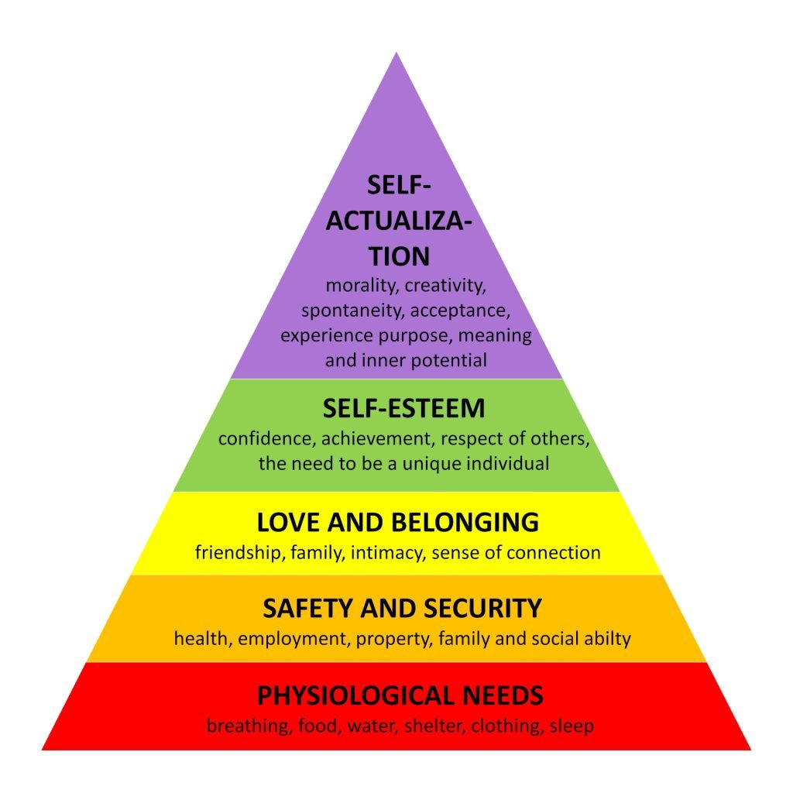
Maslow's hierarchy of needs
psychologist Abraham Maslow in his 1943 paper "A Theory of Human Motivation" in the journal Psychological Review.[

Slide 18
Personality
Development

Slide 19
Personality describes the unique patterns of thoughts, feelings, and behaviors that distinguish a person from others. A product of both biology and environment, it remains fairly consistent throughout life.
Examples of personality can be found in how we describe other people's traits. For instance, "She is generous, caring, and a bit of a perfectionist," or "They are loyal and protective of their friends."
The word "personality" stems from the Latin word persona, which refers to a theatrical mask worn by performers to play roles or disguise their identities.

Slide 20
Personality Characteristics
What exactly makes up a personality?
Traits and patterns of thought and emotion play important roles, and so do these fundamental characteristics of personality:
Consistency: There is generally a recognizable
order and regularity to behaviors. Essentially, people act in the same way or in similar ways in a variety of situations.
.

Slide 21
Personality Characteristics
.
2. Both psychological and physiological: Personality is a
psychological construct, but research suggests that it is
also influenced by biological processes and needs.
3. Affects behaviors and actions: Personality not only
influences how we move and respond in our
environment, but it also causes us to act in certain ways.
4. Multiple expressions: Personality is displayed in more
than just behavior. It can also be seen in our thoughts,
feelings, close relationships, and other social
interactions.

Slide 22
Top 5 Qualities for Good personality
Be a Good Listner
Body Language
Choose Right Book and right People
Dress Sence
Be Honest and respectful
If you keep judging people You will never have time to love them
: Mother Teresa

Slide 23
Top 6 Qualities for Good personality
Eccept Your Self
Always Keep Positive Outlook
Always Be Curious to lern new Things
Practice good etiquettes and manner
Practice Smiling and Eye contact
Punctuality
If you keep judging people You will never have time to love them
: Mother Teresa

Slide 24
Personality Types
Type theories suggest that there are a limited number of personality types that are related to biological influences.
One theory suggests there are four types of personality. They are:
Type A: Perfectionist, impatient, competitive, work-obsessed, achievement-oriented, aggressive, stressed
Type B: Low stress, even-tempered, flexible, creative, adaptable to change, patient, tendency to procrastinate
Type C: Highly conscientious, perfectionist, struggles to reveal emotions (positive and negative)
Type D: Worrying, sad, irritable, pessimistic, negative self-talk, avoidance of social situations, lack of self-confidence, fear of rejection, appears gloomy, hopeless

Slide 25
Personality Traits
Trait theories tend to view personality as the result of internal characteristics that are genetically based and include:
Agreeable: Cares about others, feels empathy, enjoys helping others
Conscientiousness: High levels of thoughtfulness, good impulse control, goal-directed behaviors
Eager-to-please: Accommodating, passive, and conforming
Extraversion: Excitability, sociability, talkativeness, assertiveness, and high amounts of emotional expressiveness
Introversion: Quiet, reserved
Neuroticism: Experiences stress and dramatic shifts in mood, feels anxious, worries about different things, gets upset easily, struggles to bounce back after stressful events
Openness: Very creative, open to trying new things, focuses on tackling new challenges

Slide 26
Personality Disorders
While personality determines what you think and how you behave, personality disorders are marked by thoughts and behavior that are disruptive and distressing in everyday life. Someone with a personality disorder may have trouble recognizing their condition because their symptoms are ingrained in their personality.

Slide 27
Personality Disorders
While personality determines what you think and how you behave, personality disorders are marked by thoughts and behavior that are disruptive and distressing in everyday life. Someone with a personality disorder may have trouble recognizing their condition because their symptoms are ingrained in their personality.

Slide 28
While the symptoms of personality disorders vary based on the condition, some common signs include:
Aggressive behavior
Delusional thinking
Distrust of others
Flat emotions (no emotional range)
Lack of interest in relationships
Violating others' boundaries

Slide 29
Summary
Understanding the psychology of personality is much more than simply an academic exercise. The findings from personality research can have important applications in the world of medicine, health, business, economics, technology, among others. By building a better understanding of how personality works, we can look for new ways to improve both personal and public health.

Slide 30
Thank You

Slide 31
Time Management

Slide 32
Time Management ?
Time management is the process of planning and exercising conscious control of time spent on specific activities
especially to increase effectiveness, efficiency, and productivity.

Slide 33
8 keys of time management?
1.Do a time audit
2.Create a daily planner
3.Set reminders for all your tasks.
4.Give each task a time limit.
5.Block out distractions.
6.Establish routine.
7.Keep your “call to action” in mind.
8.Get enough down time and rest.

Slide 34
3 P's of time Management:
3.Planning,
2.Prioritizing and
3.Performing.

Slide 35
Some of the most important time management skills include:
Prioritization. ...
Goal-setting. ...
Communication. ...
Planning. ...
Delegation. ...
Stress management. ...
Problem-solving.

Slide 36
Three D’s for Time Management
When the day seems to get out of your control early and steamroll over you for hours until you leave exhausted, you are probably missing the three “D’s”.
The three “D’s” are:
1.Do
2.Delegate
3.Defer
“Do I have to be the one to do this or do I simply need to arrange to have it done?”

Slide 37
A time management system is a designed combination of processes, tools, techniques, and methods.
Time management is usually a necessity in any project management as it determines the project completion time and scope.

Slide 38
Cultural views of time management
Differences in the way a culture views time can affect the way their time is managed.
For example, a linear time view is a way of conceiving time as flowing from one moment to the next in a linear fashion.
This linear perception of time is predominant in America along with most Northern European countries, such as Germany, Switzerland, and England.
People in these cultures tend to place a large value on productive time management and tend to avoid decisions or actions that would result in wasted time.
This linear view of time correlates to these cultures being more "monochronic", or preferring to do only one thing at a time.

Slide 39
Multi-active time view
Another cultural time view is the multi-active time view. Multi-active cultures are "polychronic" or prefer to do multiple tasks at once.
This multi-active time view is prominent in most Southern European countries such as Spain, Portugal, and Italy.
In these cultures, people often tend to spend time on things they deem to be more important such as placing a high importance on finishing social conversations
In business environments, they often pay little attention to how long meetings last, rather the focus is on having high-quality meetings. In general, the cultural focus tends to be on synergy and creativity over efficiency

Slide 40
Cyclical time view
In cyclical cultures, time is considered neither linear nor event related. Because days, months, years, seasons, and events happen in regular repetitive occurrences, time is viewed as cyclical. In this view, time is not seen as wasted because it will always come back later, This cyclical time view is prevalent throughout most countries in Asia, including Japan and China. It is more important in cultures with cyclical concepts of time to focus on completing tasks correctly, therefore most people will spend more time thinking about decisions and the impact they will have, before acting on their plans

Slide 41
Creating an effective environment
Some time-management literature stresses tasks related to creating an environment conducive to "real" effectiveness. These strategies include principles such as:
1.“Get organized"
2.“Protecting one's time" by insulation, isolation, and
delegation,
3.“Achievement through goal-management and through
goal-focus"
4.“Recovering from bad time-habits" - recovery from
underlying psychological problems,
e.g. procrastination. (Tal Matol)

Slide 42
ABCD analysis
A technique that has been used in business management for a long time is the categorization of large data into groups. These groups are often marked A, B, C and D—hence the name. Activities are ranked by these general criteria:
A – Tasks perceived as being urgent and important,
B – Tasks that are important but not urgent,
C – Tasks that are unimportant but urgent,
D – Tasks that are unimportant and not urgent.
Each group is then rank-ordered by priority - ABC analysis can incorporate more than three groups.

Slide 43
Pareto analysis
The Pareto principle is the idea that 80% of consequences come from 20% of causes.
Applied to productivity, it means that 80% of results can be achieved by doing 20% of tasks
If productivity is the aim of time management, then these tasks should be prioritized higher

Slide 44
The Eisenhower Method
Using the Eisenhower Decision Principle, tasks are evaluated using the criteria important/unimportant and urgent/not urgent and then placed in according quadrants in an Eisenhower Matrix (also known as an "Eisenhower Box" or "Eisenhower Decision Matrix Tasks in the quadrants are then handled as follows.
1.Important/Urgent quadrant tasks are done immediately and
personally e.g. crises, deadlines, problems
2.Important/Not Urgent quadrant tasks get an end date and are done
personally, e.g. relationships, planning, recreation
3.Unimportant/Urgent quadrant tasks are delegated, e.g.
interruptions, meetings, activities.
4.Unimportant/Not Urgent quadrant tasks are dropped, e.g. time
wasters, pleasant activities, trivia.

Slide 45
POSEC method
POSEC is an acronym for "Prioritize by Organizing, Streamlining, Economizing and Contributing". It suggests that by attending to one's personal responsibilities first, an individual is better positioned to shoulder collective responsibilities. It mirrors Maslow's hierarchy of needs.
Prioritize your time and define your life by goals.
1.Organize things you have to accomplish regularly to be successful
(family and finances).
2.Streamline things you may not like to do, but must do (work and
chores - Rudhi wadi).
3.Economize things you should do or may even like to do, but they're
not pressingly urgent (pastimes and socializing).
4.Contribute by paying attention to the few remaining things that
make a difference (social obligations).

Slide 46
Time management systems
Time management systems often include a time clock or web-based application used to track an employee's work hours.
Time management systems give employers insights into their workforce, allowing them to see, plan and manage employees' time.
Doing so allows employers to manage labor costs and increase productivity. A time management system automates processes, which eliminates paperwork and tedious tasks.

Slide 47
GTD (Getting Things Done)
Getting Things Done was created by David Allen. The basic idea behind this method is to finish all the small tasks immediately and a big task is to be divided into smaller tasks to start completing now.
The reasoning behind this is to avoid the information overload or "brain freeze" which is likely to occur when there are hundreds of tasks.
The thrust of GTD is to encourage the user to get their tasks and ideas out and on paper and organized as quickly as possible so they're easy to manage and see.

Slide 48
Pomodoro
Francesco Cirillo's "Pomodoro Technique" was originally conceived in the late 1980s and gradually refined until it was later defined in 1992.
The technique is the namesake of a Pomodoro (Italian for tomato) shaped kitchen timer initially used by Cirillo during his time at university.
The "Pomodoro" is described as the fundamental metric of time within the technique and is traditionally defined as being 30 minutes long, consisting of 25 minutes of work and 5 minutes of break time.
Cirillo also recommends a longer break of 15 to 30 minutes after every four Pomodoros. Through experimentation involving various workgroups and mentoring activities, Cirillo determined the "ideal Pomodoro" to be 20–35 minutes long

Slide 49
Thank You

